Slide 1
The Software Development Life Cycle: New or Old which works best for modern iOS development?
By: Asum Zahid, Ihechineme Umunnakwe, Imane Bigaume, Jinrui Cao

Slide 2
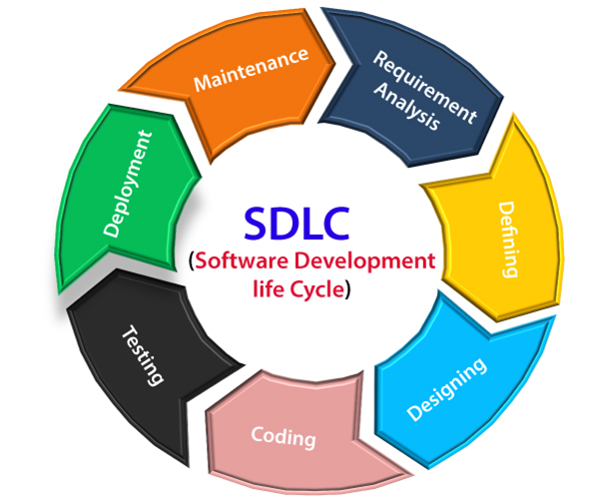
Introduction
The objective of our research is to create our own software development life cycle and test its feasibility, by implementing it into an ios APP. The purpose of creating a new software development life cycle is to make it more effective and efficient then the standard SDLC. The two main methodologies we are looking to improve on are the waterfall and agile life cycles; while also taking inspiration from the shift left testing model. The issue with older waterfall life cycles is the lack of testing where the testing is only conducted towards the end, with the shift left model there is an abundance of testing which minimizes chance of defects/errors. Every software development life cycle has its standard phases as seen in this image. Our goal is to improve upon this process. The tools we are going to be using to develop our own ios APP include a virtual machine, the use of the IDE Xcode and certain API’s.
Fig 1. Classical Life Cycle Model

Slide 3
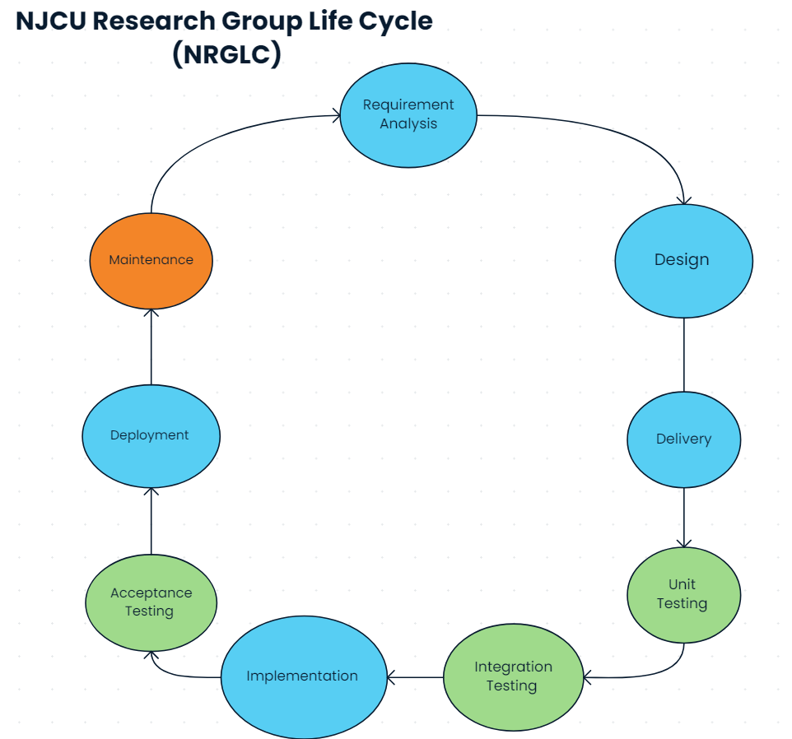
Fig 2. NJCU Research Group Life Cycle

Slide 4
Requirement Analysis -
The user wants us to create an ios News APP. The function of this APP has to include specified features such as once the APP opens, a plethora of news articles will appear and the user has the ability to either click, bookmark or share certain news article’s. While also being able to search through your saved bookmarks in the specified bookmark tab section for saved articles. The user should also be able to search for any specified news article and that search history should be able to be saved for later reference unless it is cleared by the user. Furthermore, after clicking on the specified article you will be forwarded to a link where you can view the entirety of the article whilst being able to scroll and share as you would be able to normally.

Slide 5
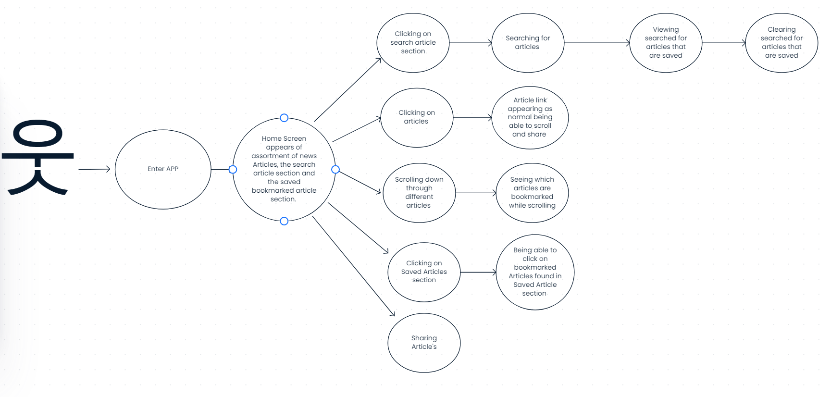
Design
Fig 3. News App Design Phase

Slide 6
Delivery
This phase serves as a collaborative forum for developers to exchange diverse ideas and approaches as they work on fulfilling their assigned tasks. Within this context, developers are provided with specific tasks that pertain to the construction of the application, with the expectation of completing each task within a specified time frame. As they progress through their individual tasks, they are encouraged to share any intriguing discoveries or innovative methods they encounter during their development process.
Furthermore, a new task is assigned to the developers on a weekly basis until the entire project or application reaches completion. This iterative approach allows for continuous progress and encourages ongoing knowledge-sharing among team members. By fostering an environment of open communication and idea exchange, the development team can benefit from each other's insights and experiences, leading to the creation of a robust and well-constructed application.

Slide 7
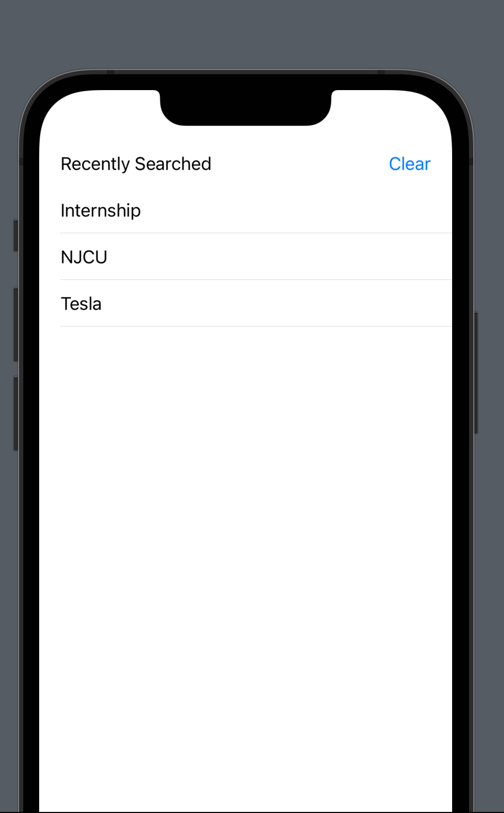
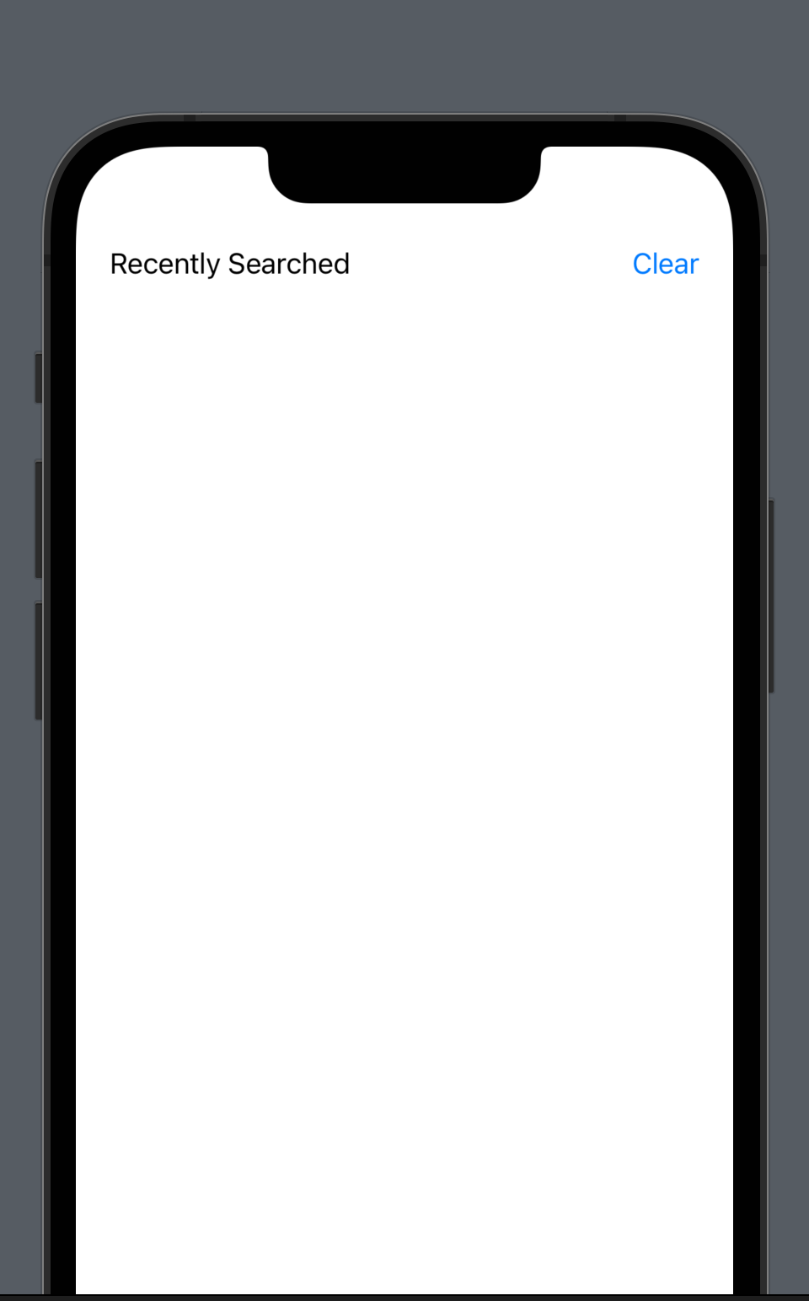
Unit Testing
Incorporating Unit Testing enables the targeted evaluation of discrete components within the application, exemplified by scenarios such as examining the functionality of clicking on the recently searched history, viewing one's recent search records, and validating the capability to clear this history. This systematic approach to testing enhances the precision and efficiency of assessing the individual features, contributing to an overall robust and reliable application.

Slide 8
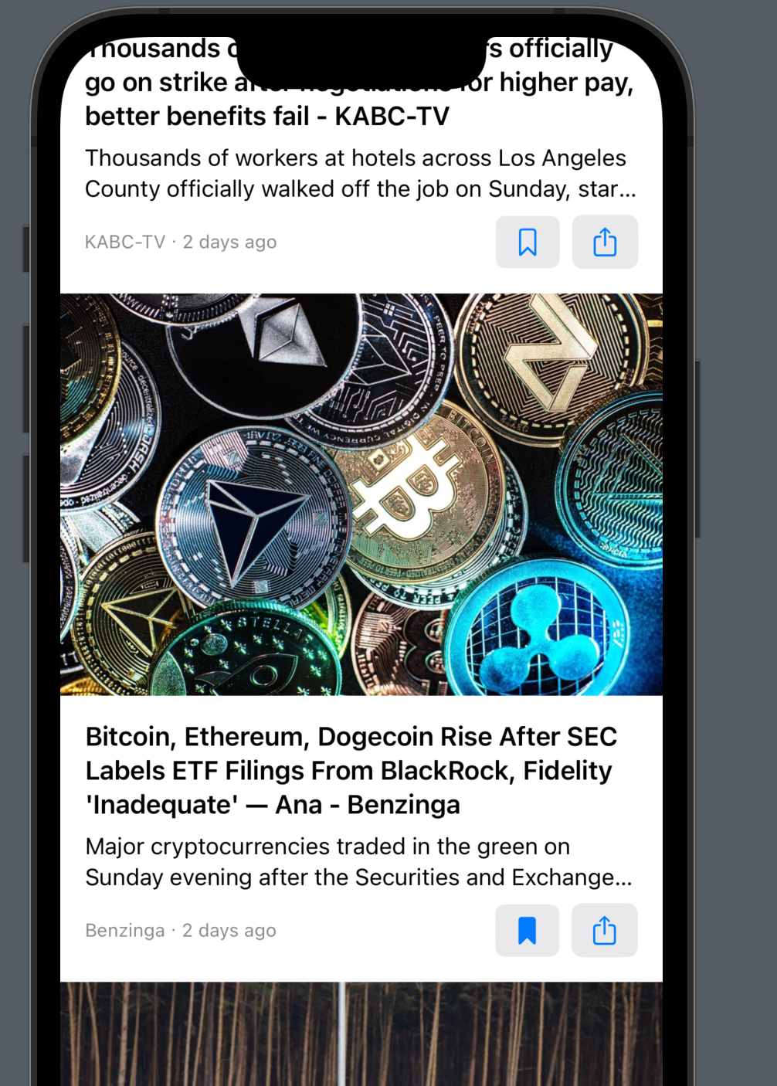
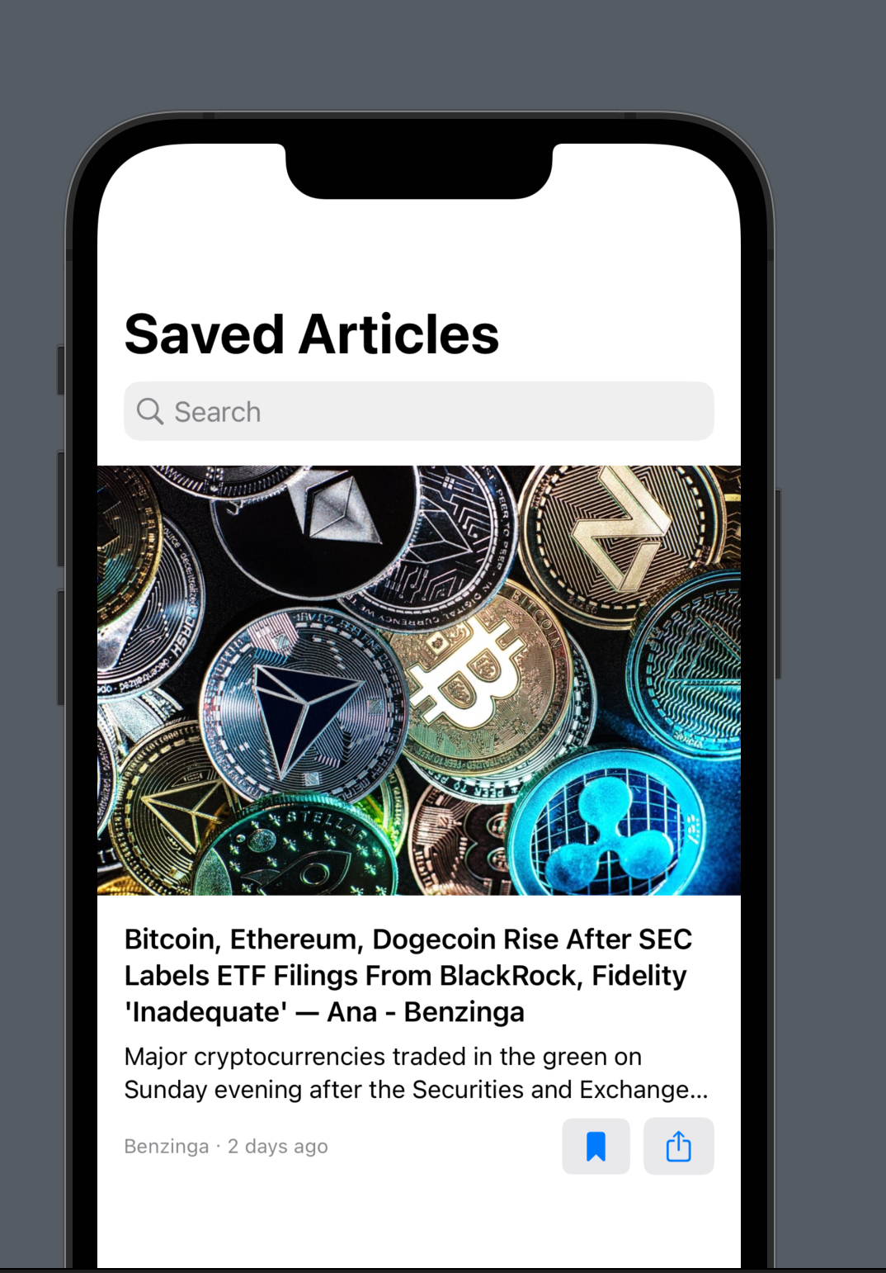
Integration Testing
Integration Testing facilitates the comprehensive examination of multiple interconnected functionalities within the application. For instance, it enables us to verify the seamless process of accessing an article from the homepage, utilizing the bookmark functionality to save that article while navigating through other articles on the homepage, and subsequently validating the presence of the specified bookmarked article in the designated "saved article's" section. By evaluating these interdependent components in an integrated manner, this testing approach ensures the smooth coordination and proper functioning of diverse features, thereby bolstering the overall performance and user experience of the application.

Slide 9
Implementation
After the initial testing phases the next step is to work on the entirety of the App, ensuring all features are fully developed allowing for the fully functional app to run smoothly. Developing the rest of the user requirements. Through the use of the xcode automation testing we are able to execute and monitor the software. When the development, building and monitoring has been completed the last step in the implementation phase is to move the software into its final stage of production.

Slide 10
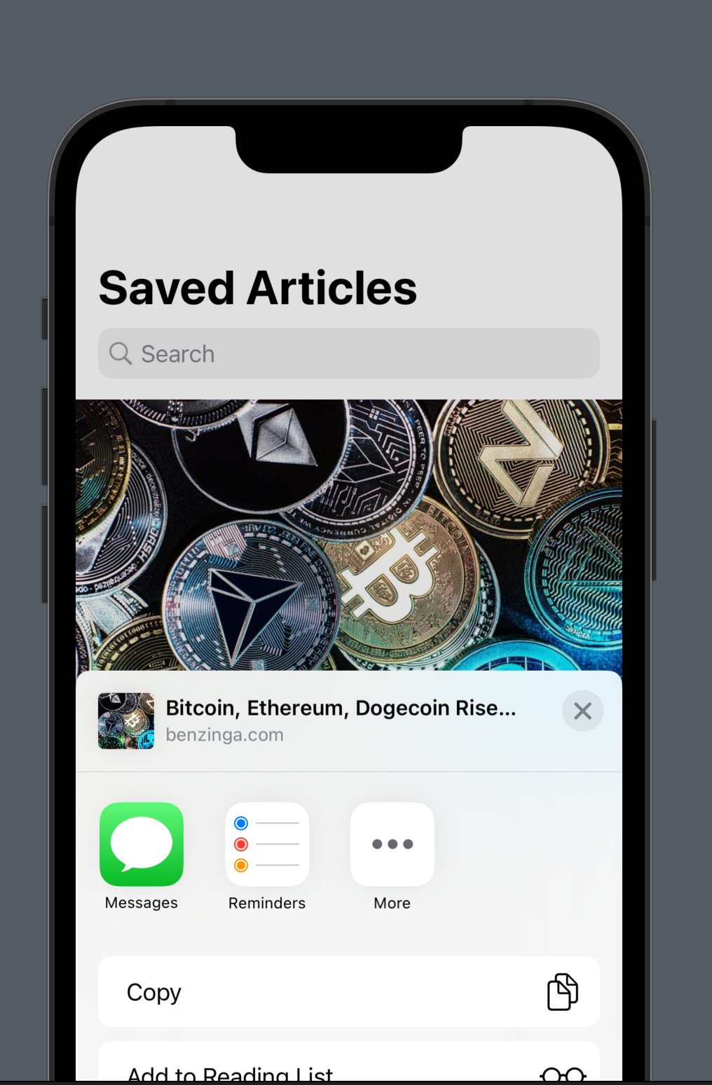

Acceptance Testing
The final phase of testing, our focus lies in meticulously validating whether all specified requirements have been successfully met. This comprehensive testing process plays a critical role in ensuring that the application is fully functional, meeting all intended requirements, and ready to be deployed with confidence

Slide 11
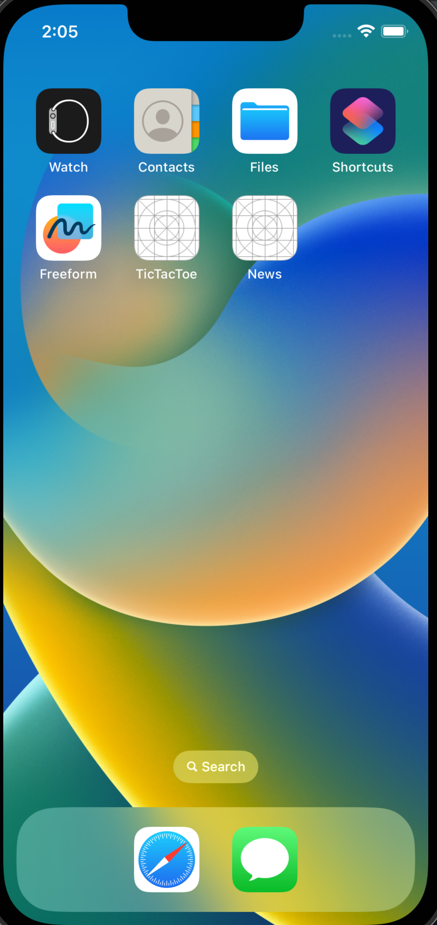
Deployment / Maintenance
The final steps of the software development process deploying the fully functional app and maintaining it by having separate, independent components in the app makes it easier to fix errors. When an issue arises, we can quickly identify and navigate to the specific component responsible for the problem. This streamlined approach speeds up the debugging process, leading to quicker resolutions. Additionally, the modular structure improves code organization and maintainability, allowing for easier updates and feature enhancements. Overall, this approach ensures a more efficient and agile development process.

Slide 12
Conclusion
In conclusion with the addition of our extra testing phases the chance of potential errors are limited which solves the fragility of the waterfall methodology. Resulting in a smooth development of our news App due to utilizing the built-in automation that Xcode has. Our findings suggest that leaning towards a more modern agile methodology is more optimal because of its comprehensive testing. However without a proper deliverance the agile methodology can easily fall off track in order to overcome this weakness we built an app with clear requirements. Combing the clear requirements found in a waterfall approach and the agile/shift left model of testing more individual components provides for a unique more refined software development process.
Acknowledgements -
US Education Department Title III Part F HSI-STEM Grant # P031C210145
US Education Department Title V DHSI Grant # P031S200124
Grant Number - Setting the Stage - 3500385

